Slide 1


Slide 2
Mission
Foster Angel Investing in Florida
by offering a disciplined & rewarding investment approach for accredited investors while streamlining the funding process for entrepreneurs

Slide 3
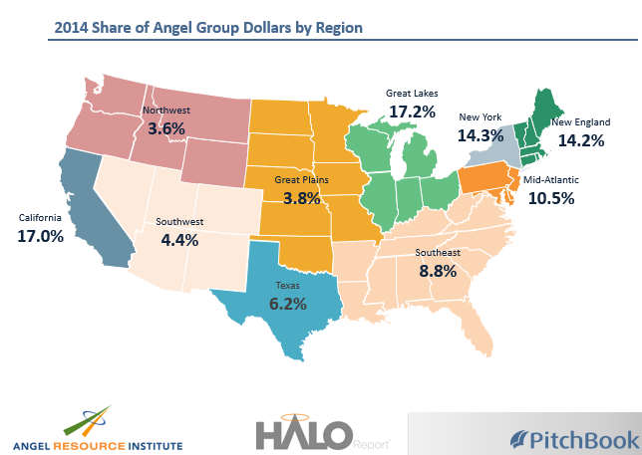
Why do we exist?

Slide 4
Nexus Update
Founded in 2013 with the support of Tom O’Neal, Michael O’Donnell, UCF, and the Florida High Tech Corridor
Grown from working with 15 investors in Orlando to over 80 spanning Central and North Florida

Slide 5
Nexus Update
Currently launching the FAN Tallahassee chapter in partnership with their local government, chambers, and FSU
FANlando has committed over $2MM
Through co-investment, collaborated to raise over $4.5MM for early-stage ventures in Florida

Slide 6
Now Fundraising!

Slide 7
FAN Investors Fund I, LP
The natural evolution of a successful “pass the hat” model
Professionally managed & committed angel fund
Targeting $20 million capital raise
Seeking capital appreciation by:
Investing in growth-oriented opportunities
Focusing on technology and life science sectors
Locating within underserved, capital efficient market of Florida
Allocating capital based on portfolio strategy
Hands-on approach with its pipeline and portfolio companies
Collaborating with members of the Florida Angel Nexus

Slide 8
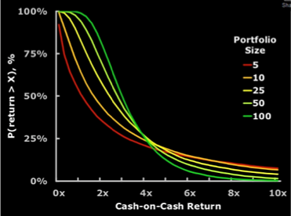
Angel Groups Evolving into Managed Funds Example: Boston’s Common Angels
Consistent Due Diligence
Maximize Industry Expertise
Enable Portfolio Approach
Simplify Engagement Process
Portfolio approach is a key to mitigating some of the inherent risk

Slide 9
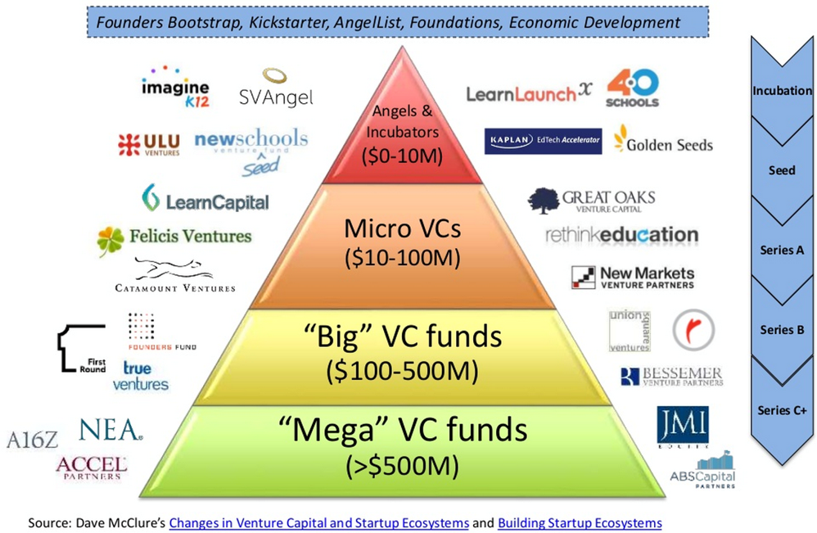
We Invest in Early Stages

Slide 10
Investment Considerations
Technology or Life Science with operations in FL
Strategy includes multiple exit options within 3-7 years
Company can establish a sustainable market niche
Have an established product and/or service in $1B market
Have revenues of $0-10 million with known economic model
Are at a transition point in their strategic growth alternatives

Slide 11
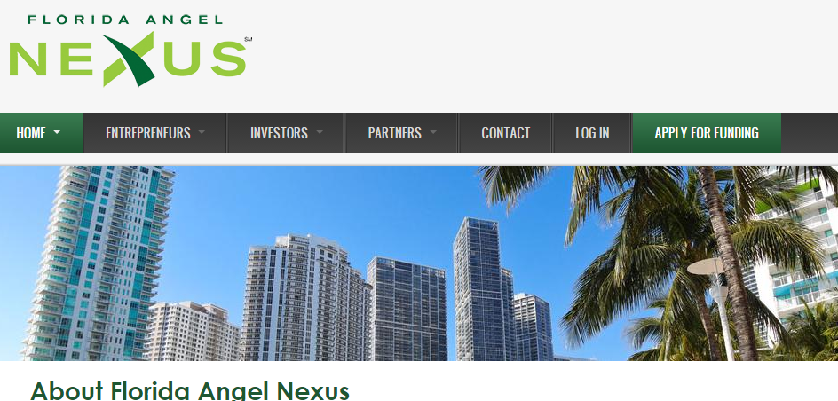
Companies apply by visiting FloridaAngelNexus.com

Slide 12
Common Issues
Lack of evidence to validate assumptions & business model
Market size
Financial model
Competitive analysis
Exit comparables
Investment pitch

Slide 13
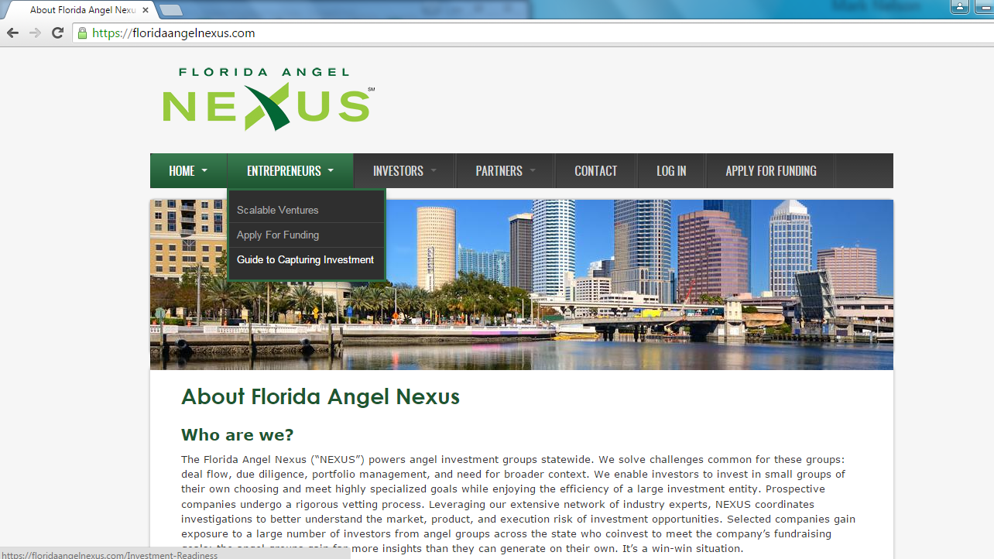

Slide 14
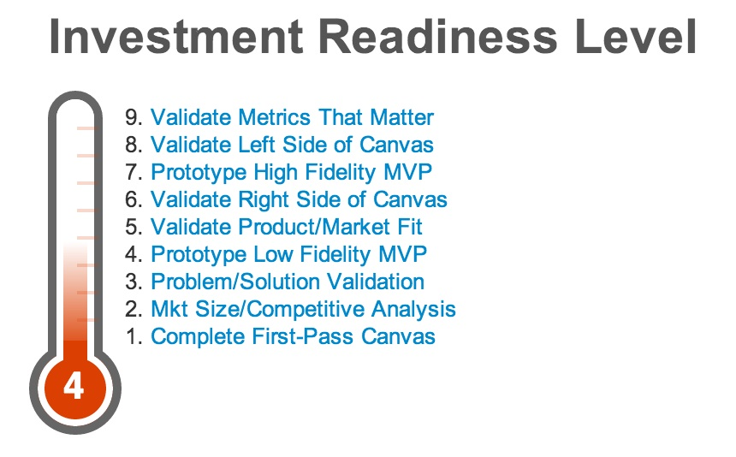
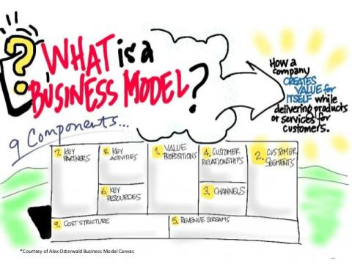

Slide 15
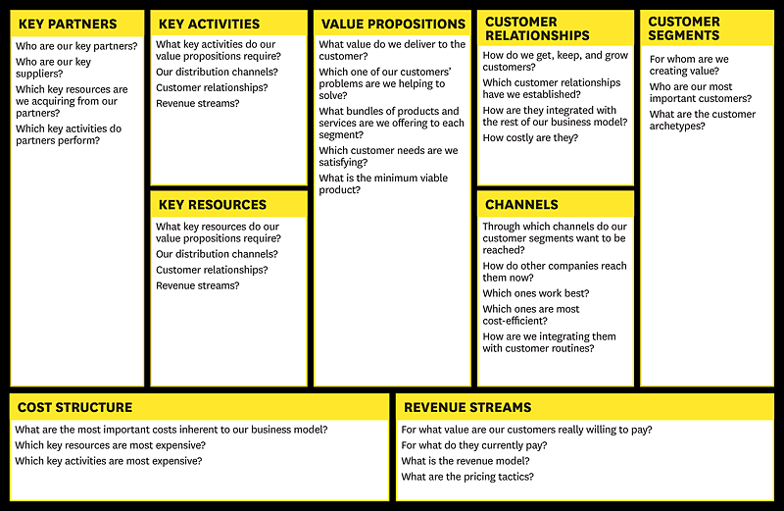

Slide 16
Why take the time?
Goal is to:
Preserve cash while guesses are turned into facts
Identify the sales model that scales the best
Proof that you have a business rather than a hobby:
Customer feedback and orders
Users for your buggy, unfinished product with a minimum feature set
This process even works for Life Science

Slide 17
How does this affect your pitch?
Pitch covers the same ground
Evidence and lessons learned from customers & stakeholders are intertwined into presentation
Reduces risk while increasing credibility & probability of raising funding

Slide 18
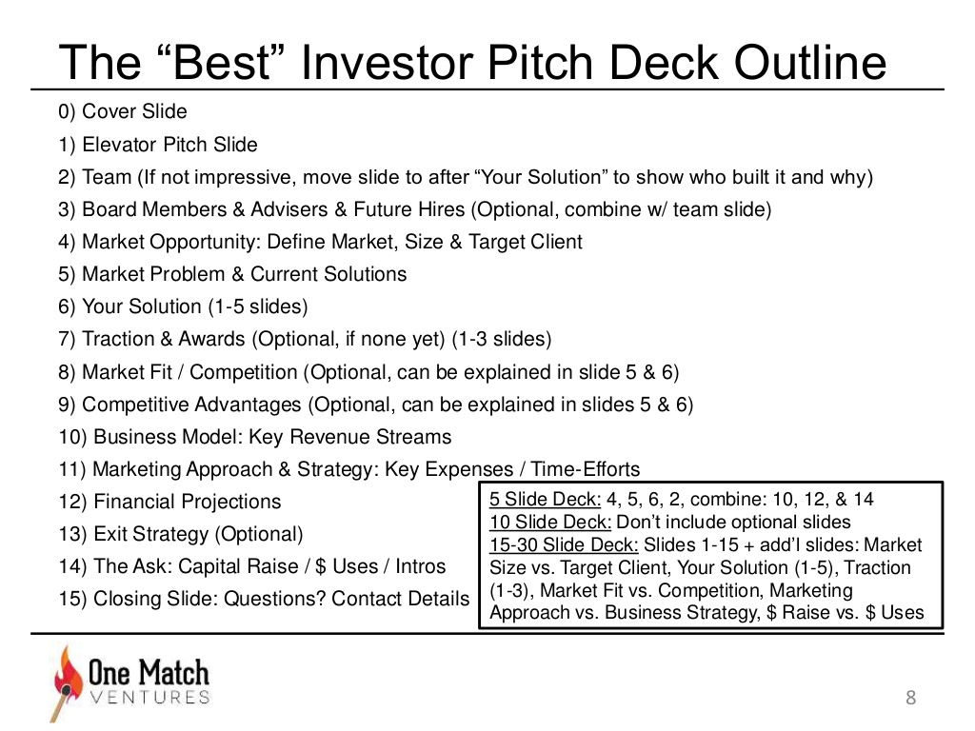

Slide 19
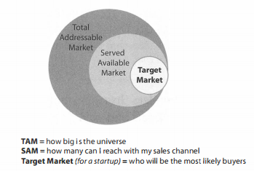
Bottom Up Market Sizing
What is your total addressable market?
How many customers can I reach with my sales channel(s)?
Define your target client & their key characteristics?
How many of these people exist?
How much are they willing to pay you?
How do you know?
# of potential units x your revenue/unit

Slide 20
Don’t use top down
"I will sell a widget everyone can use, and since there are 300,000 people in my area, even if I only manage to land 5% of that market I'll make 15,000 sales.”
15,000 x price/widget = market size

Slide 21
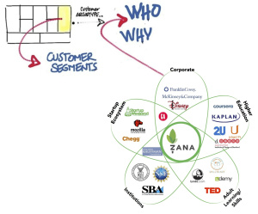
Competitive Analysis
Competition exists in each customer segment (direct & indirect)

Slide 22

Exit Comparables
Acquisition = most likely exit option
Name potential companies (any unique relationship?)
Types/categories of companies that could acquire
Why they’d be interested? How would it fit into their strategy?
Why won’t they build it themselves?
What drives exits in this space? (revenue, # of users, geographic scope, talent, IP)
Examples of pertinent exits? How was value calculated?

Slide 23
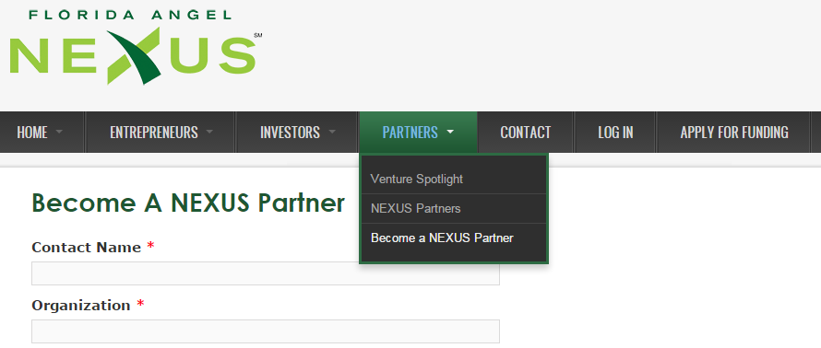
We want to Partner with You!

Slide 24
Questions and Answers

Slide 25
Appendix

Slide 26
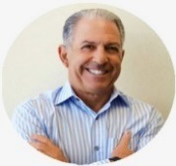

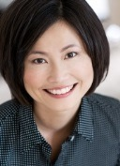
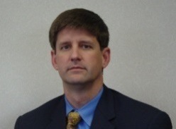
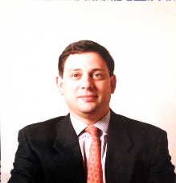
Principals
Mitchel Laskey - Founder, Entrepreneur, Strategic Advisor, Venture Investor, Corporate Governance, CPA, Executive Leader developing technology companies
Michael O’Donnell - Founder, Entrepreneur, Angel Investor, Chief Technology Investment Officer, University Executive Office of Innovation and Entrepreneurship
Kathy Chiu - COO Angel Network, Venture Capitalist, Research Analyst, Consultant & Advisor, Masters Electrical Engineering - MIT, MBA Stanford
Ben Patz - Founder, Entrepreneur, Technologist, Principle Investigator SBIR grants, Masters Electrical Engineering, Ernst & Young Entrepreneur of the year award
Marcelo Chao - Founder, Entrepreneur, Managing Director Private Equity Fund - $6 billion invested in 120 companies, Strategic Consultant, CPA

Slide 27
Advisors
Gregg Pollack
Founder of Envy Labs & Code School
Founder Starter Studio
Orlando, Florida
Jamie Grooms
CEO, Florida Institute for the Commercialization of Public Research Gainesville, Florida
Donna Mackenzie
Executive Director, Starter Studio
Orlando, Florida
Ronald Hammond
President/CEO, Ronin Associates International St. Petersburg, Florida
Jackson Streeter, M.D.
CEO Banyan Biomarkers
Gainesville, Florida
Sherrick (Rick) Wassel
Managing Director, IQ Orlando
Executive Director, Florida Hospital Adventist Health System
Orlando, Florida
Richard Bernstein
Of Counsel at Greenberg Traurig
Miami, Florida

Slide 28
Fund Terms
Partnership Fund | FAN Investors Fund I, LP
General Partner | FAN Investors I GP, LLC
Manager | FAN Management Partners, LLC
Target Raise | $20 million
Minimum Raise | $5 million
Principals’ Investment | Minimum $1,000,000
Profit Split | 80% Limited Partner / 20% General Partner after return of capital
Investment Period | 4 Years
Management Fee | 2½% of committed capital during investment period,1½% thereafter
Minimum Commitment | $100,000 with 40% of commitment due at subscription = $40,000 down
Expected Distributions | At portfolio company exits
Targeted Returns | 3–5x over life of investment or 40% annualized IRR
Subscription Escrow Agent | CNL Bank
Independent Auditors | Cross, Fernandez & Riley, LLP
Legal Counsel | Burr & Forman LLP

Slide 29
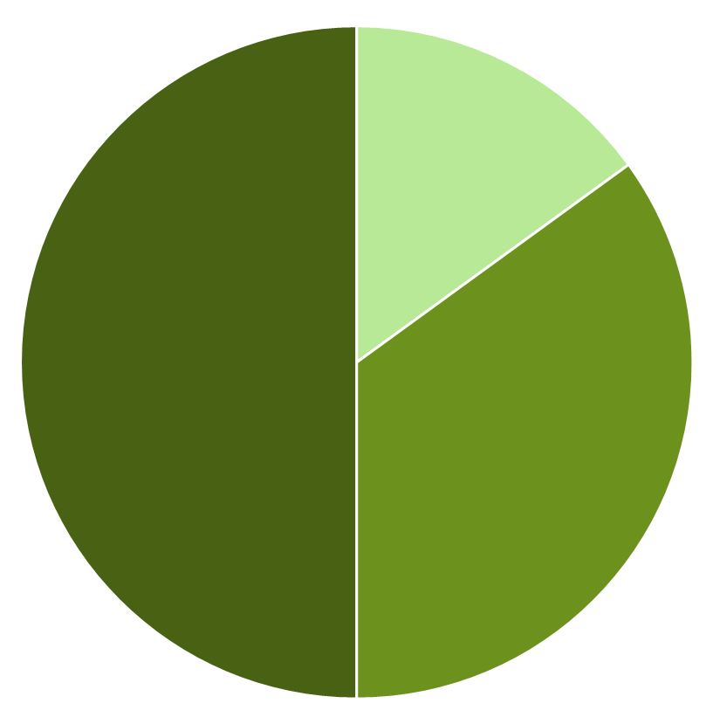
Planned Capital Allocation
Seed Stage
10-20% of capital
Majority of the deal volume
Strategic Allocation
40-60% of Capital
Follow-on capital & maneuvering
Early Stage
30-40% of the capital
Minority of deal volume
No more than 15% in any one investment
Defendable deal terms or mechanisms

Slide 30
Summary of FAN Investors Fund I, LP
Natural evolution of the “pass the hat” model for angel investing
Following a trend for “pooled angel investing”
Professionally managed committed angel capital fund
Opportunity to invest in seed and early stage utilizing a portfolio approach
Angel capital as an asset class provides highest historical returns
Located and investing in Florida’s emerging market
Focused on growth oriented technology and life science opportunities
Unique and leveraged relationship with Florida Angel Nexus
Talented, experienced, and successful General Partners and Advisor team
“Hands-on approach” to the investment process and risk mitigation
Participate with management on exit alternatives to maximize returns

Slide 31
Mitchel J. Laskey, Managing Director of MJL Advisors, Inc.; Co-founder and Board of Directors of CNL Bank; Past Chairman of the Board of IZEA (OTC: IZEA); Co-founder and CEO of Dynamic Healthcare Technologies (NASDAQ: DHTI) a leading health care information systems company – merged with (NSADAQ: CERN). Held other senior executive management and leadership positions for public and private companies (including 4 positions of CEO), developing entrepreneurial technology companies in healthcare, electronic manufacturing, physical security, and transportation industries. Has served as a member of the board of directors for numerous non-profit, private, and public companies. Testified before Congress regarding Homeland Securities issues and holds active Secret Clearance with the U.S. Government; South Florida College of Business Administration’s “Entrepreneur of the Year”, BA degree in both accounting and marketing from the University of South Florida. Licensed CPA in Florida.
Michael J. O’Donnell, Sr., Executive Director of the Office of Innovation and Entrepreneurship University of Central Florida and Director of the UCF Venture Accelerator; Founder and Chairman of the Board of NEXUS; Founder and CEO of ALS, LLC, a specialized industrial staffing company. Grew the company to over 6,000 employees and to an exit through acquisition; Managing Director, Board Member, and Chief Technology Investment Officer for GATX; Invested in over 60 seed, early, and growth stage deals; BS in Business Administration from Central Michigan University; MS in Management from the University of Central Florida.

Slide 32
Kathy Chiu, COO of Florida Angel Nexus; Wireless venture capitalist at Denver-based iSherpa Capital; Consultant to clients from startups to Fortune 500; Research analyst with Boston economics consulting firm Cornerstone Research; business development, strategy, product management at Level (3) Communications, Lefthand Networks, Compaq Computers; Technical roles at Tektronix, MIT Media Lab, and Superconducting Supercollider Lab, BSEE and MSEE from MIT; MBA form Stanford Graduate School of Business. Speaks fluent Chinese and Taiwanese.
Ben Patz, Founder and CEO Coleman Technologies. Grew sales to $250M and exited in 2009; COO of Presidio until 2013, running operations and led the company’s M&A activities; Principal investigator on a number of SBIR grants relating to the application of Fuzzy Logic and Neural Networks to control systems; Led the UCF team to finals in DARPA Urban Challenge, an autonomous vehicle competition; Specialty: computation, control systems, and simulations; MSEE degree from the University of Central Florida; BSEE from Rensselaer Polytechnic Institute; Ernst & Young’s Entrepreneur of the Year award for Florida in 2002; UCF’s Professional Achievement Award in 2006.

Slide 33
Marcelo G. Chao, Founder and CEO of Bondis Entertainment S.A., a brand development and content distribution firm. Partner at Imagen Deportiva S.A. (2010-2012), which produced sports events featuring the likes of Messi, Roger Federer, Pete Sampras, and Andre Agassi; Managing Director at The Exxel Group (2000 to 2009), a private equity group in Latin America that invested approximately $6 billion in 120 companies, over 50 acquisitions and 30 exits; Partner at Hermes Management Consulting (1995 to 2000), a strategic consulting firm; VP at Citibank; served on the board of directors of Mako Surgical Corp, Brijot Imaging, The Protective Group Inc, Latin American and the Caribbean Board of MasterCard International, and Thingmagic Inc. Bachelor of Science in business administration from Universidad Catolica Argentina, attaining honors; Certified Public Accountant in Argentina.

